Slide 1













Evolving Landscapes of Television:
An Analytical Dive into TV Show Trends on Netflix
Images - Netflix

Slide 2






Who’s presenting?
Ammarah
Eoghan
Nana
Nida
Safa
MANAGE PROFILES

Slide 3

Source
Notes:
The show remains Netflix’s biggest-ever hit: in the first month after its release subscribers spent around 1.65bn hours watching it, equivalent to 190,000 years.

Slide 4
Research Questions
1
How has Netflix’s content strategy for TV shows evolved?
2
What are the factors that determine a show’s success/popularity?
3
Has there been a shift in target audience demographics?
4
Did the pandemic change tastes in favour of reality TV?

Slide 5

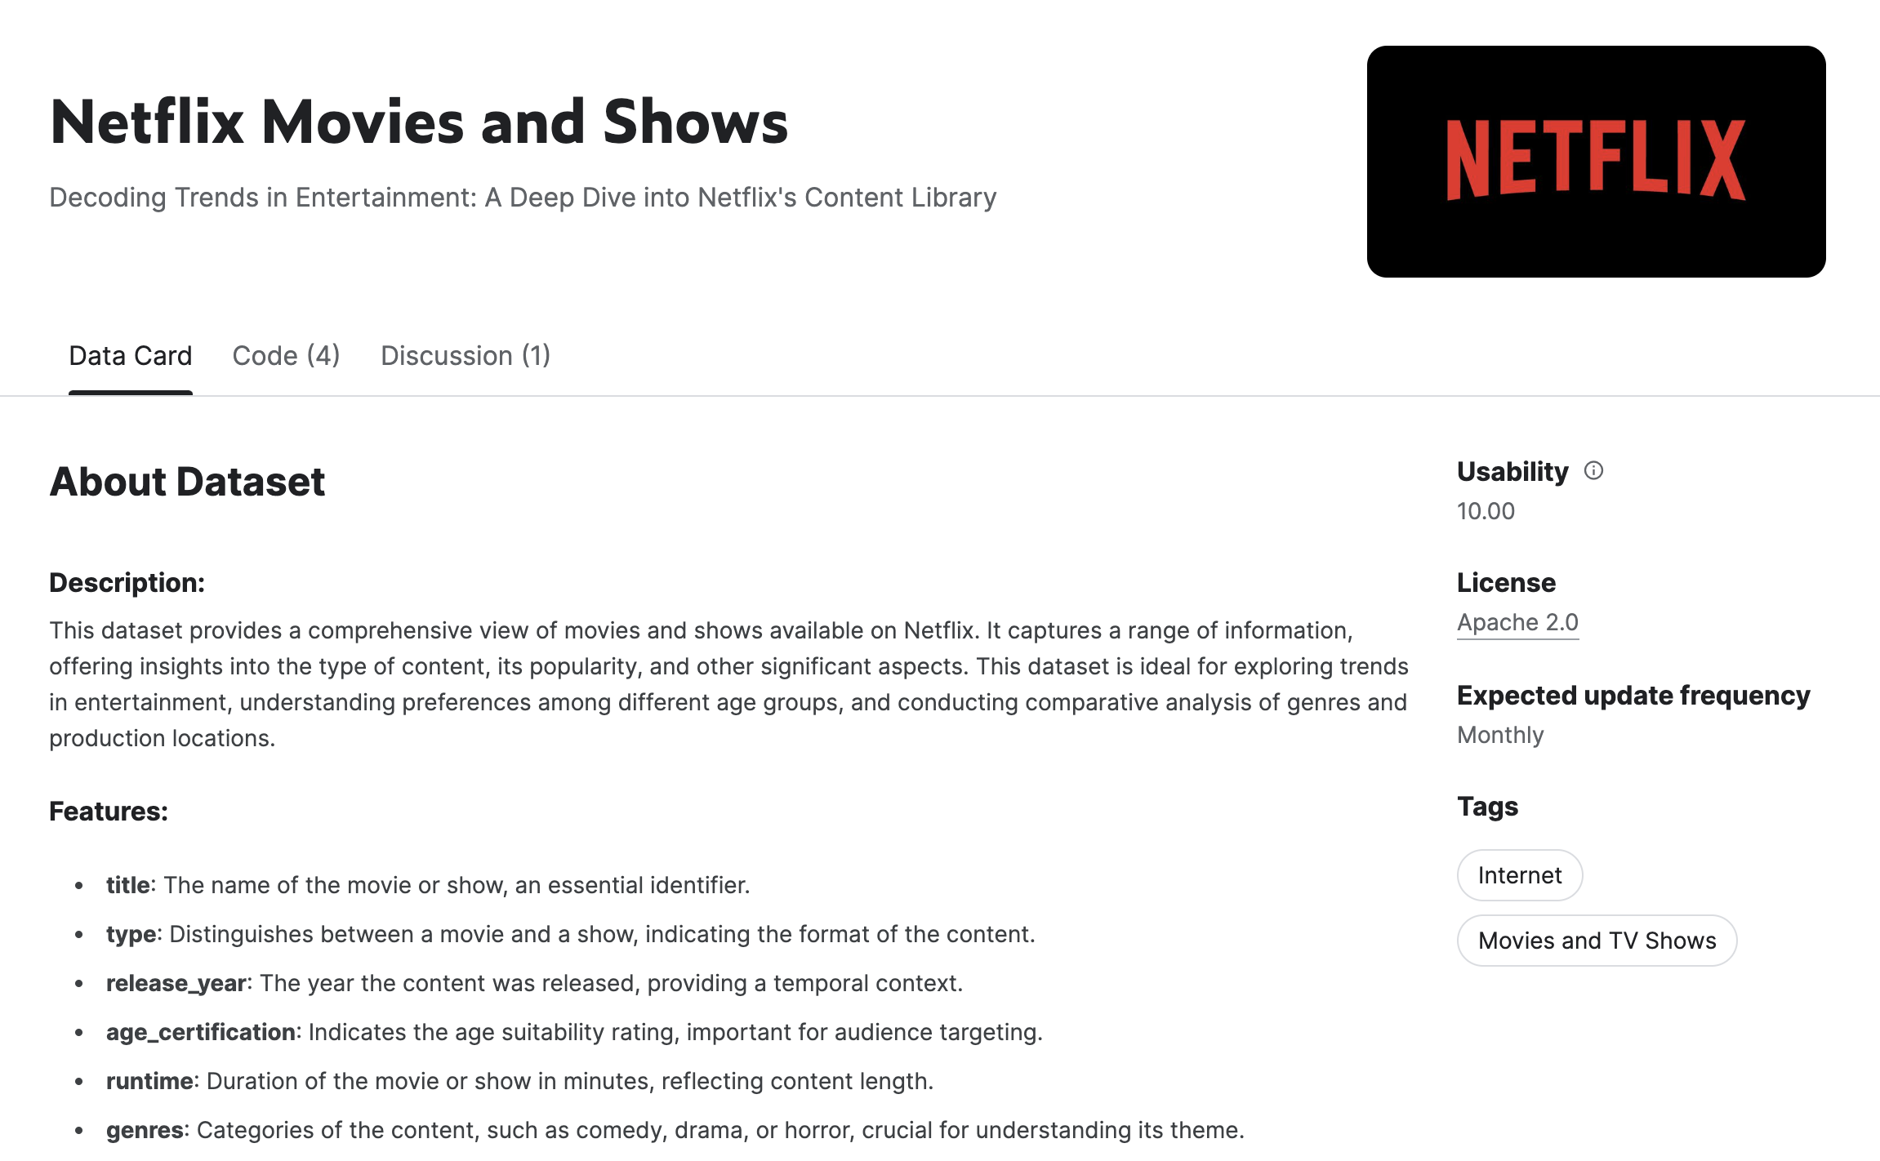
The Dataset

Slide 6
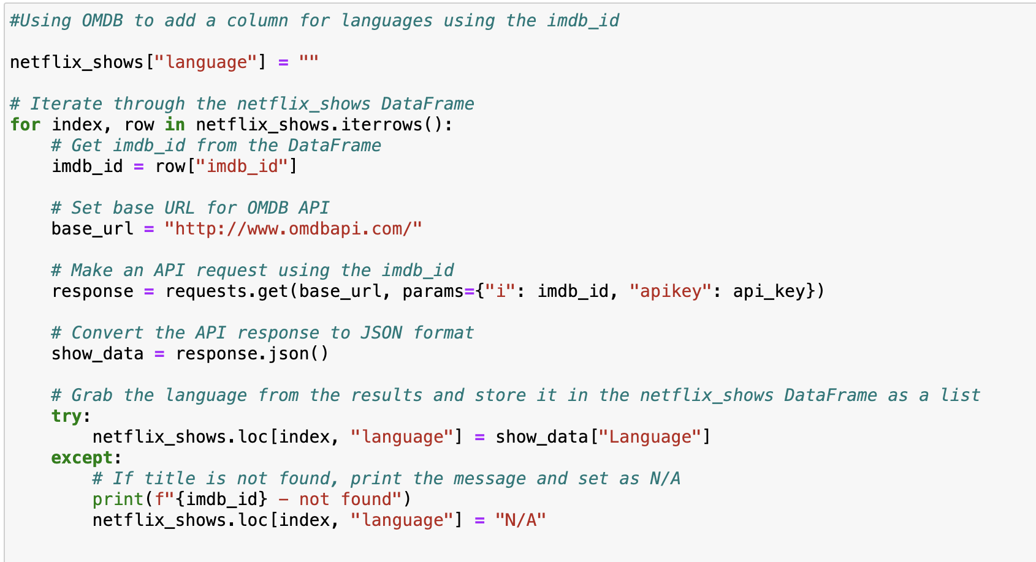
OMDB API to supplement the primary dataset
Notes:
The dataset contains 1,670 data points, each representing a different show on Netflix, with details such as the title, release year, age certification, runtime, language, genres, production countries, number of seasons, IMDb score, and IMDb votes. It is a comprehensive collection of data pertaining to Netflix shows, useful for analysis of content trends, popularity, and distribution.

Slide 7
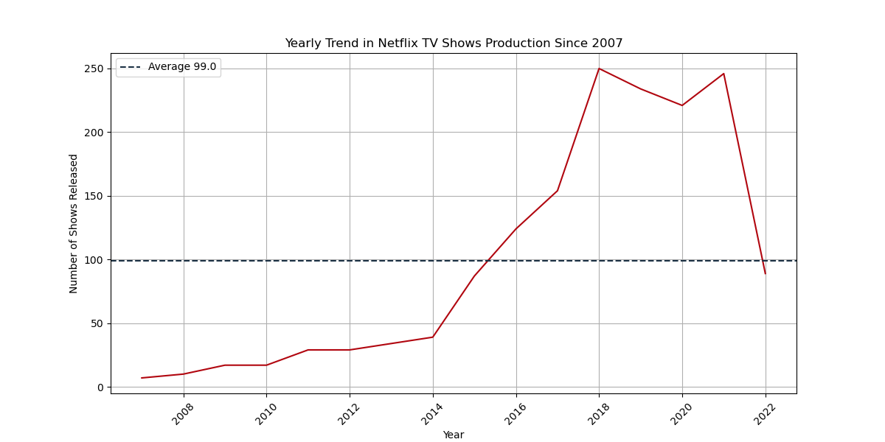

1
How has Netflix’s content strategy for TV shows evolved?
Notes:
Yearly Trend in Netflix TV Shows Production Since 2007: This line graph shows the number of TV shows released on Netflix per year from around 2007 to 2022. The graph indicates a general increase in the number of shows produced over time, with a peak around 2020 before a sharp decline. A dotted line shows the average number of shows released over this period.

Slide 8
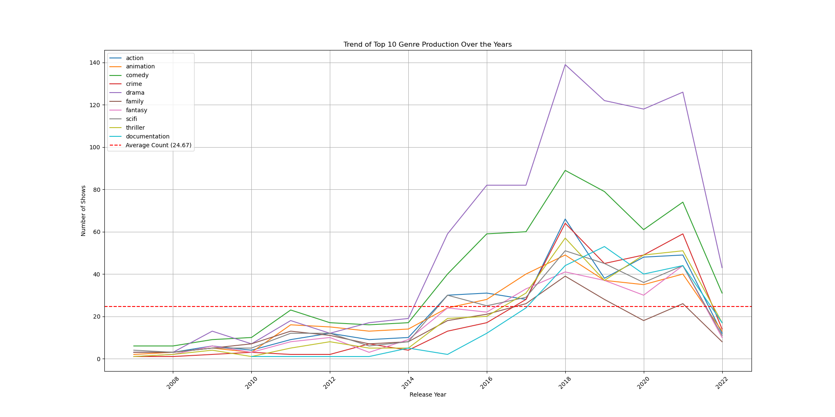
1
How has Netflix’s content strategy for TV shows evolved?
Notes:
Trend of Top 10 Genre Production Over the Years: This line graph illustrates the production trends of the top 10 TV show genres over the same timeframe. Each genre is represented by a different coloured line, and there is a dashed line indicating the average count of shows produced across these genres.

Slide 9
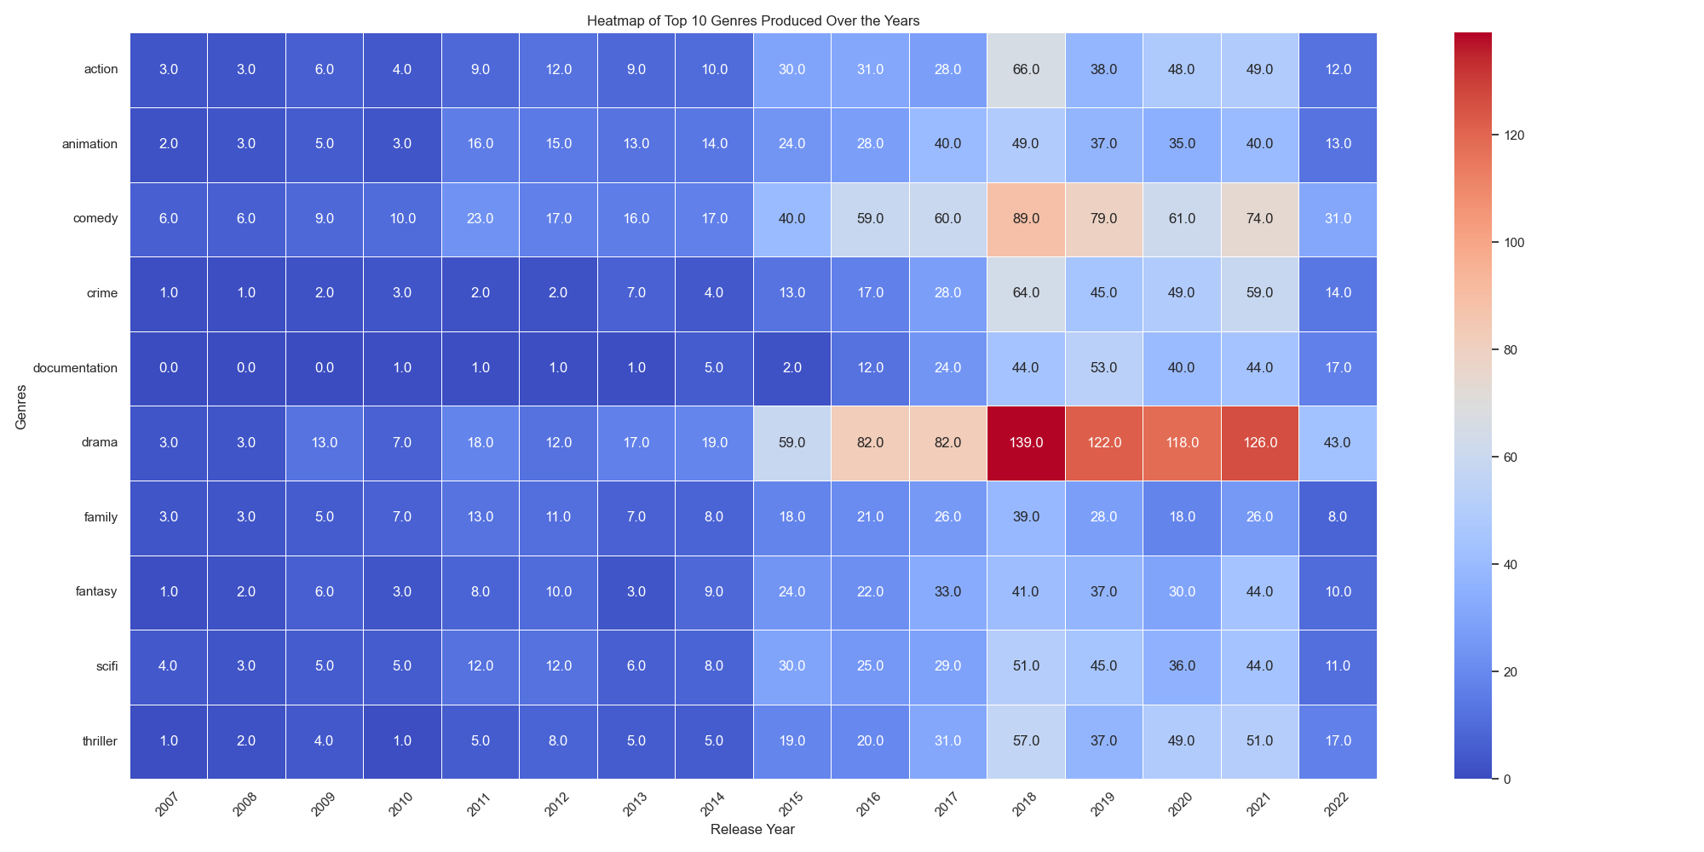
1
How has Netflix’s content strategy for TV shows evolved?
Notes:
Heatmap of Top 10 Genres Produced Over the Years: This heatmap visualizes the number of TV shows produced in the top 10 genres from 2007 to 2022. The intensity of the color correlates with the number of productions: the darker the color, the higher the number of shows. This type of visualization helps quickly identify which genres and years saw the most production.

Slide 10
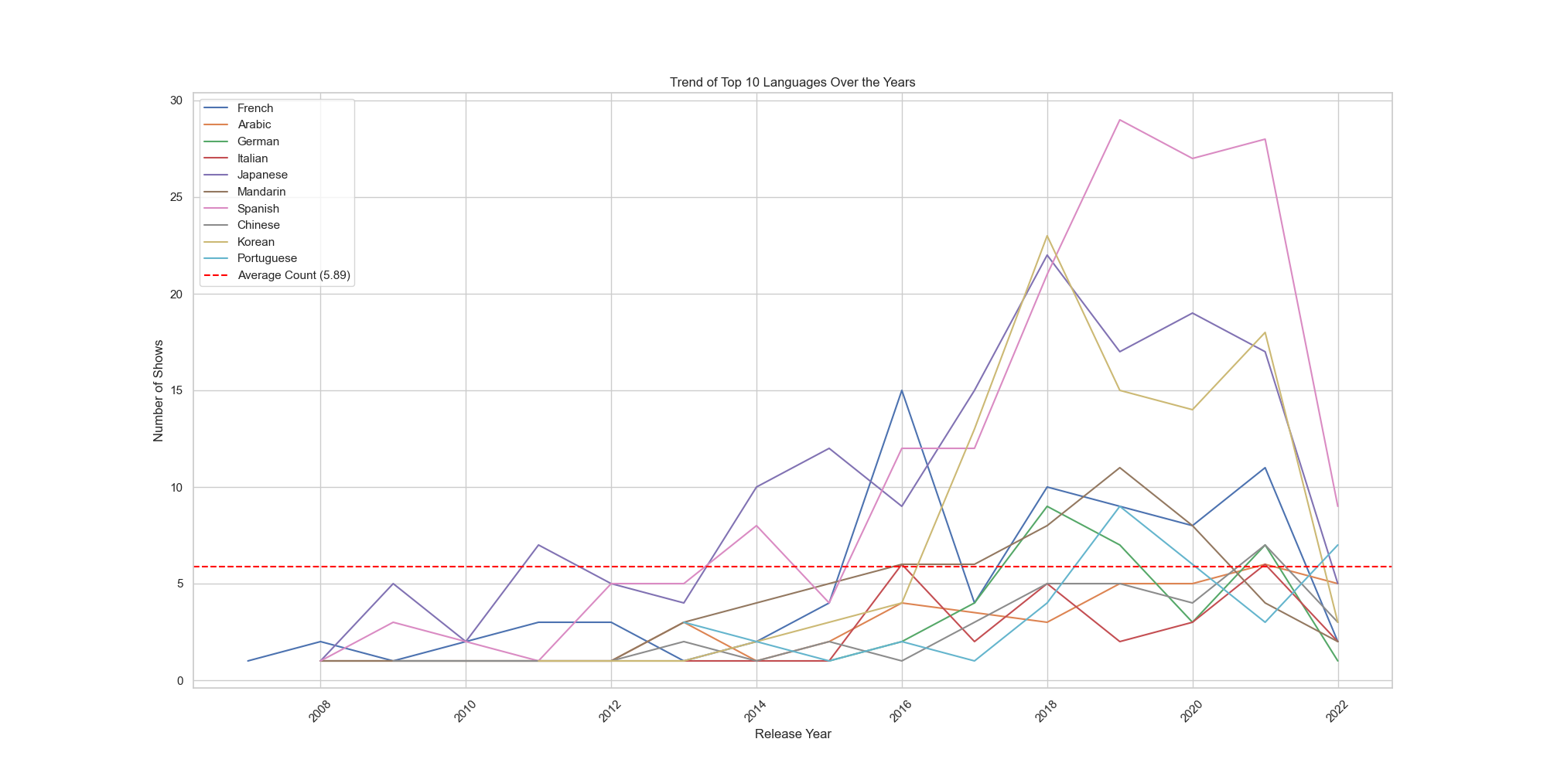
1
How has Netflix’s content strategy for TV shows evolved?

Slide 11
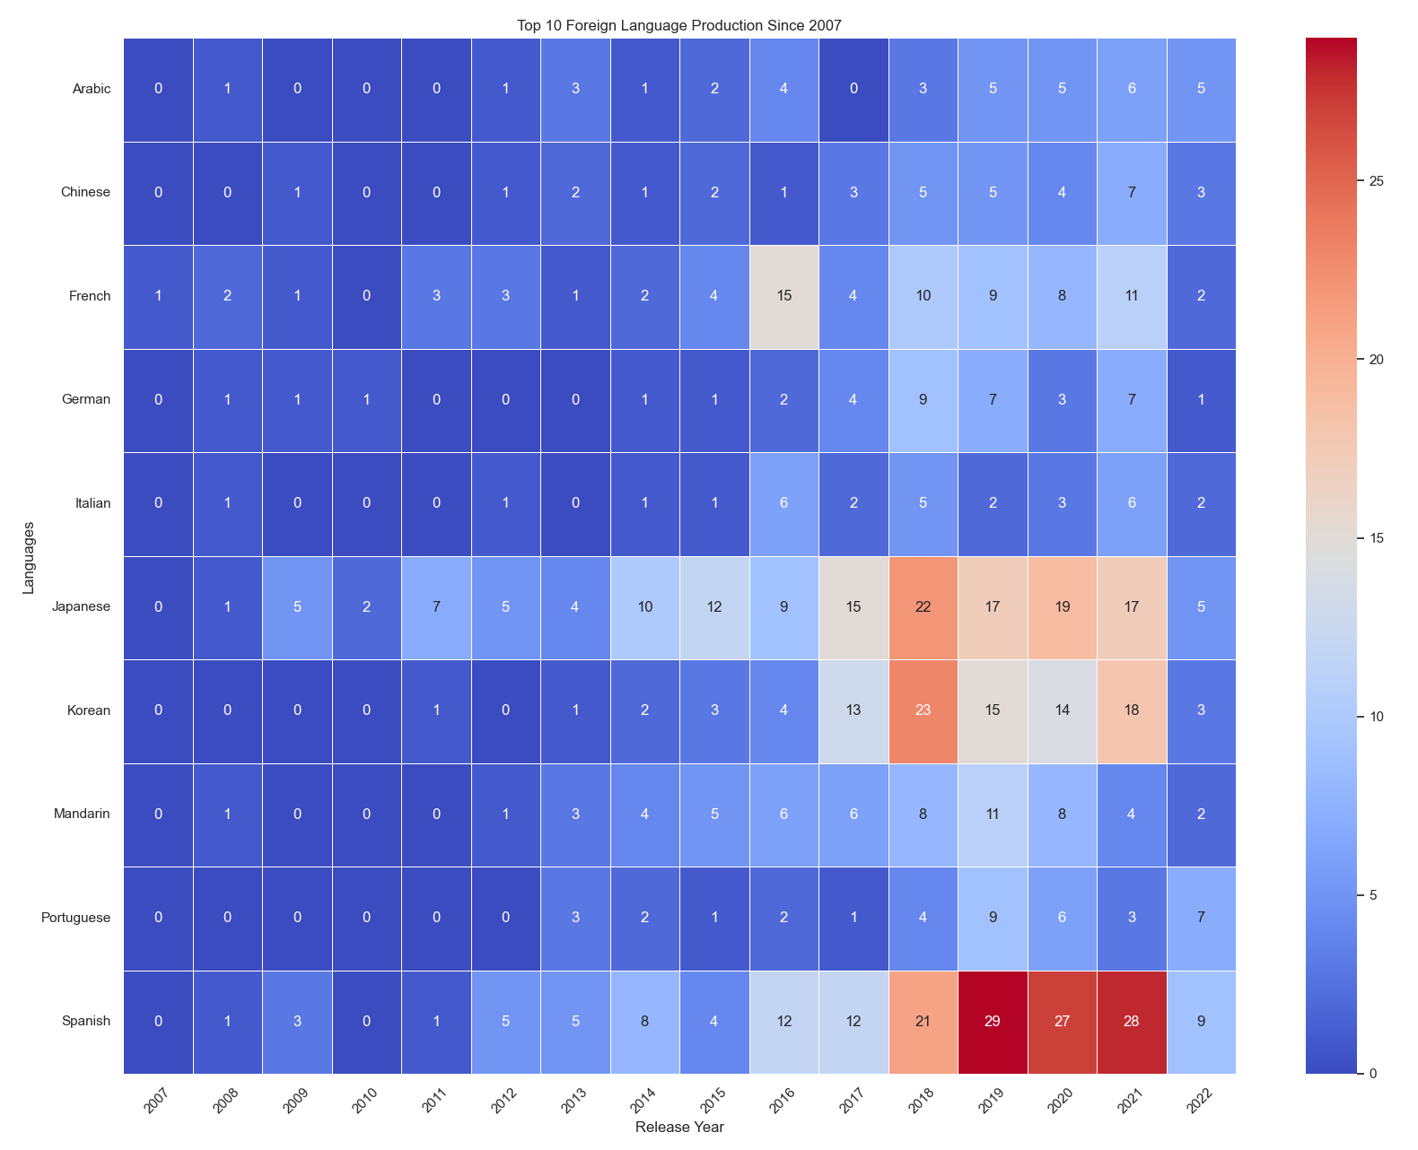
1
How has Netflix’s content strategy for TV shows evolved?
Notes:
There has been a significant increase in the production of TV shows on Netflix since 2007, with a notable peak around 2020.
Drama appears to be a consistently popular genre, with a substantial increase in production over time, especially in recent years.
The production of content in non-English languages has also been increasing, with a particularly noticeable growth in shows in Japanese, Korean, and Spanish, reflecting a diversification in Netflix's offerings.
The heatmaps provide a clear visualization of which genres and languages have been more prevalent over the years, with darker shades indicating higher numbers of productions.
There is a sharp decrease in both the production of TV shows across genres and languages in the last year shown on the graphs, which may indicate a shift in strategy, market conditions, or external factors affecting production.

Slide 12
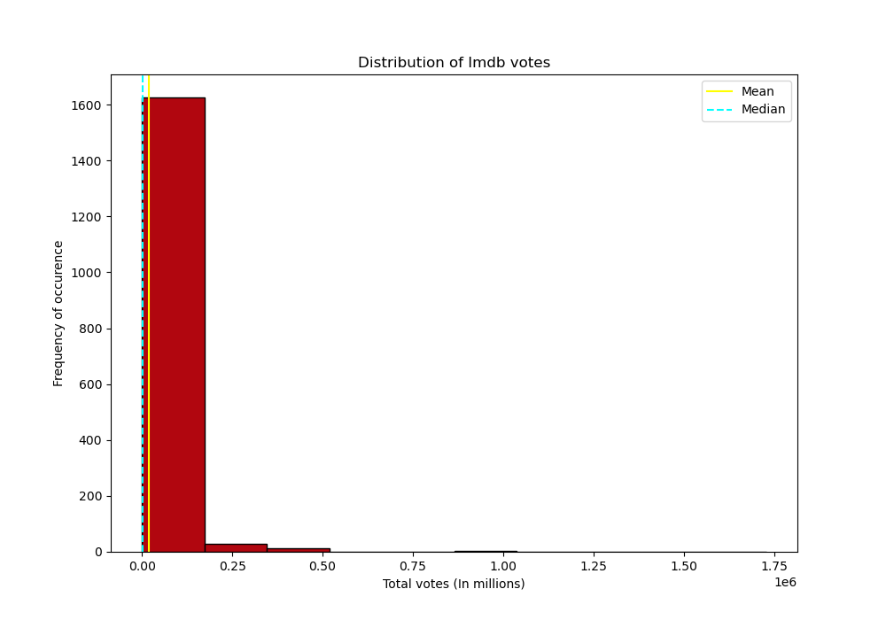
2
What are the factors that determine a show’s success/popularity?
Notes:
Distribution of Total Votes (In millions): This histogram displays the distribution of IMDb votes for different shows or movies. The x-axis represents the total votes in millions, and the y-axis represents the frequency of occurrence. The mean and median of the distribution are indicated by horizontal lines. The distribution is heavily skewed to the left, showing that most shows have a relatively small number of votes, with very few shows receiving votes in the millions.

Slide 13
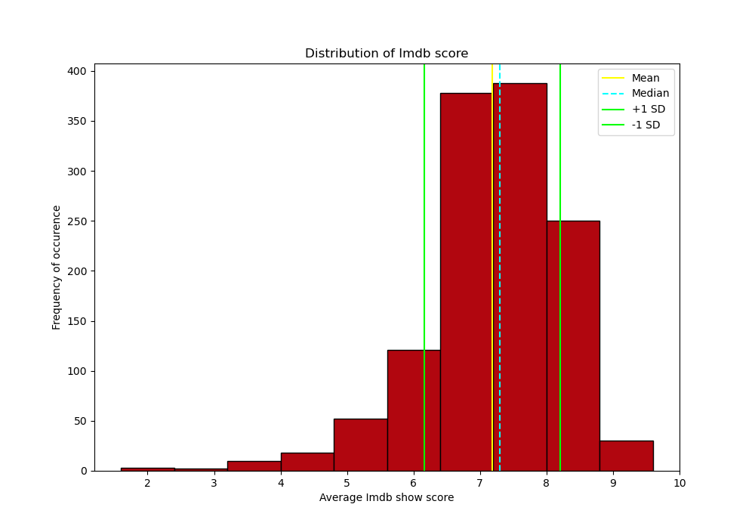
2
What are the factors that determine a show’s success/popularity?
Notes:
Distribution of IMDb Scores: This histogram shows the distribution of IMDb scores for various shows or movies. The scores range from 2 to 10. The mean and median are indicated, along with lines representing one standard deviation above and below the mean. The distribution appears to be roughly normal, centered around a score of 6 to 7.

Slide 14
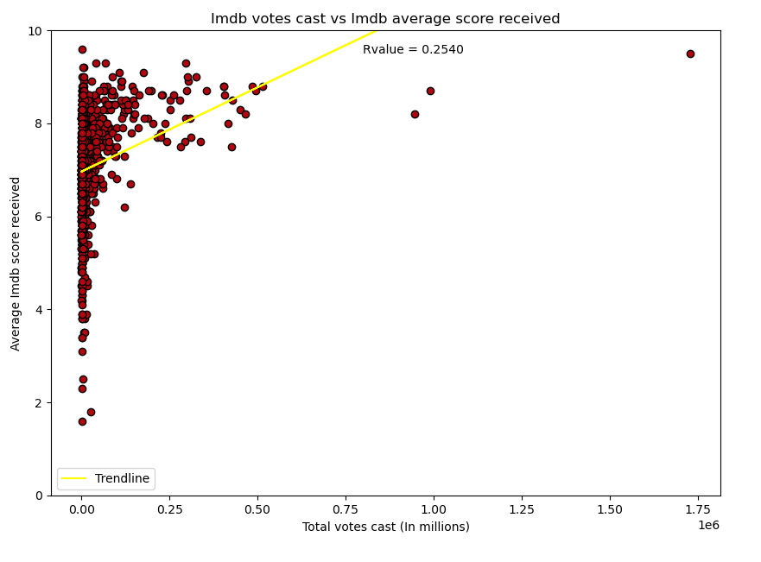
2
What are the factors that determine a show’s success/popularity?
Notes:
Scatter Plot of Votes vs. Scores: This scatter plot presents the relationship between the total number of votes a show receives and its IMDb score. Each point represents a show, with the x-axis indicating total votes and the y-axis representing the score received. A trendline is added to indicate the direction of the relationship, and an R-value is provided to denote the strength and direction of the correlation. The R-value suggests a weak positive correlation, indicating that shows with more votes tend to have slightly higher scores.

Slide 15
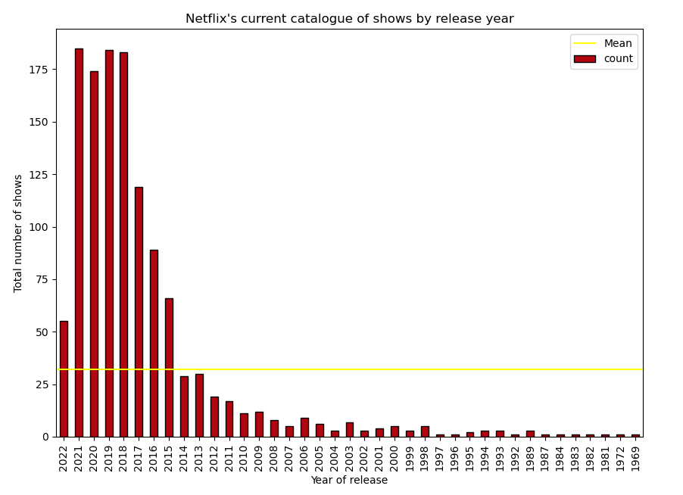
2
What are the factors that determine a show’s success/popularity?
Notes:
Total Number of Shows by Year of Release: This bar chart indicates the number of shows released each year. The x-axis represents the year of release, and the y-axis represents the total number of shows. A horizontal line indicates the mean count of shows released per year. The chart shows a decline in the number of shows released in more recent years.

Slide 16
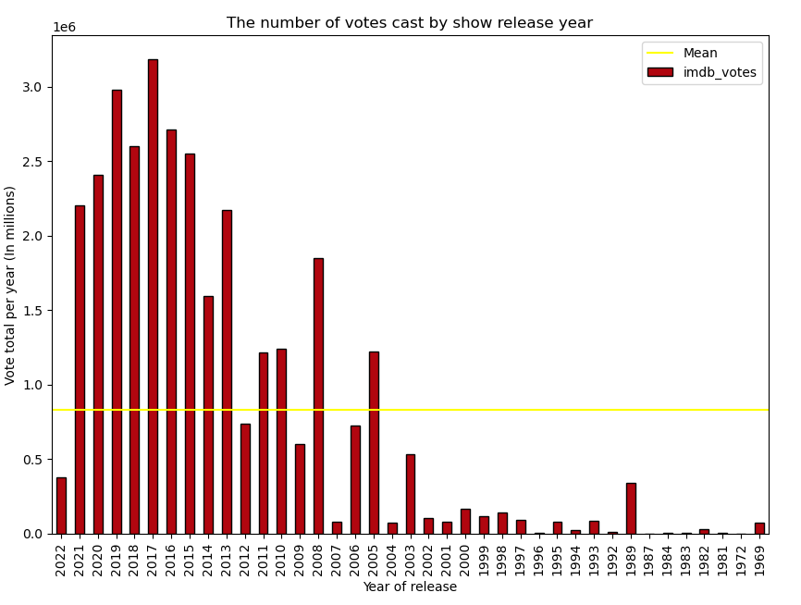
2
What are the factors that determine a show’s success/popularity?
Notes:
Total Number of Votes per Year: This bar chart shows the total number of IMDb votes received by shows per year of release. The x-axis represents the year of release, and the y-axis represents the total votes per year. A horizontal line indicates the mean number of votes per year. There is a noticeable decline in the number of votes in the most recent years shown.
Overall Summary:
The distribution of votes is highly skewed, with a large number of shows receiving few votes and a small number of shows receiving a high number of votes.
The distribution of scores is roughly normal with a mean score around 6 to 7.
There is a weak positive correlation between the number of votes and the score received, suggesting that more popular shows (with more votes) tend to have higher scores.
Both the number of shows and the total number of votes have declined in recent years according to the last two graphs. This could suggest a shift in viewing habits, a change in the number of shows being produced or rated, or other market dynamics.

Slide 17
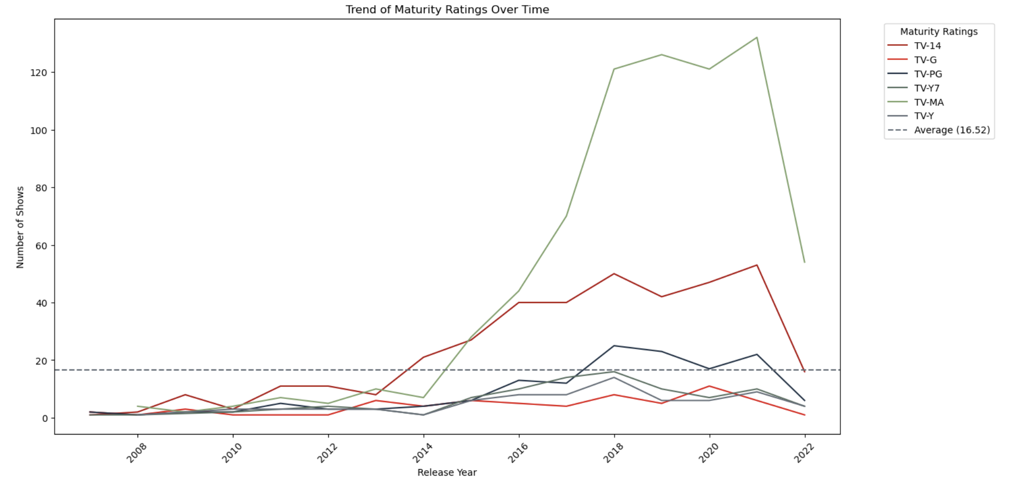
3
Has there been a shift in target audience demographics?
Notes:
Trend of Maturity Ratings Over Time: This line graph shows the number of shows produced each year categorized by different maturity ratings (TV-14, TV-G, TV-PG, TV-Y, TV-MA, TV-Y7). It illustrates how production numbers in each maturity category have changed over time. The dotted line represents the average number of shows across all maturity ratings.

Slide 18
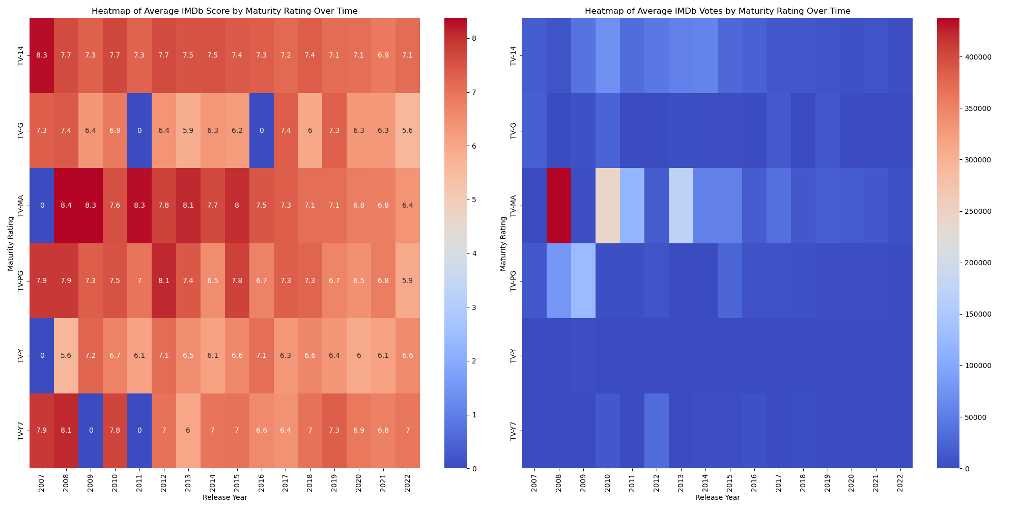
3
Has there been a shift in target audience demographics?
Notes:
Heatmap of Average IMDb Score by Maturity Rating Over Time & Heatmap of Average IMDb Votes by Maturity Rating Over Time: These heatmaps visualize the average IMDb scores and the average number of IMDb votes for shows within each maturity rating over time. Darker colors represent higher scores or more votes. These visualizations allow for a quick comparison of scores and votes across maturity ratings and over the years.

Slide 19
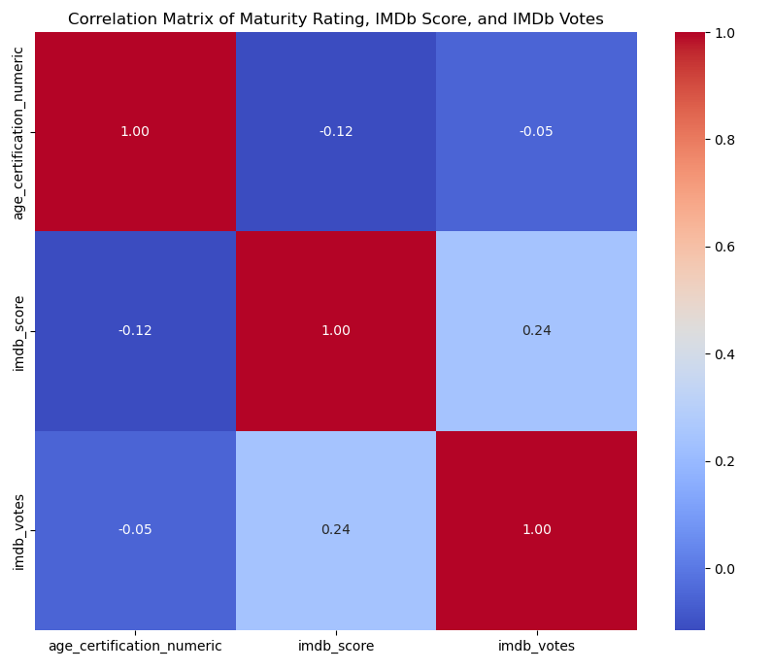
3
Has there been a shift in target audience demographics?
Notes:
Correlation Matrix of Maturity Rating, IMDb Score, and IMDb Votes: This matrix provides the correlation coefficients between maturity rating (as a numeric value), IMDb score, and IMDb votes. The color intensity and direction (red for positive, blue for negative) indicate the strength and direction of the correlations. For example, if one square is a dark red, it indicates a strong positive correlation between the two variables it compares.
Overall Summary:
There has been variability over the years in the number of shows produced across different maturity ratings, with some years seeing peaks in production for certain ratings.
The IMDb scores vary by maturity rating, suggesting that audience perception of quality may be associated with the intended audience age group.
The number of votes, which can be an indicator of popularity, also varies across maturity ratings and over time.
The heatmaps allow for a detailed comparison of how scores and votes change over time within each maturity category.
The correlation matrix suggests that there are only weak relationships between the maturity rating of a show, its IMDb score, and the number of votes it receives, indicating that maturity may not be a strong predictor of a show’s perceived quality or popularity.

Slide 20
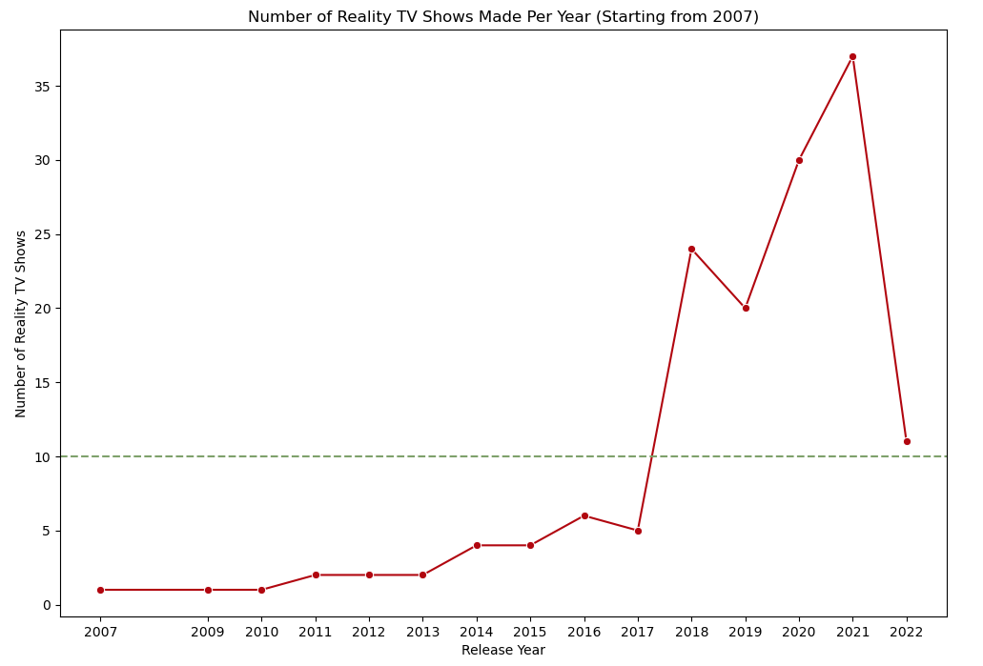
4
Did the pandemic change tastes in favour of reality TV?
Notes:
Number of Reality TV Shows Made Per Year (Starting from 2007): This line graph displays the number of reality TV shows produced each year starting from 2007. There is a notable increase in the number of shows produced in recent years, with a peak around 2021, indicating a growth in popularity or investment in the reality TV genre.

Slide 21
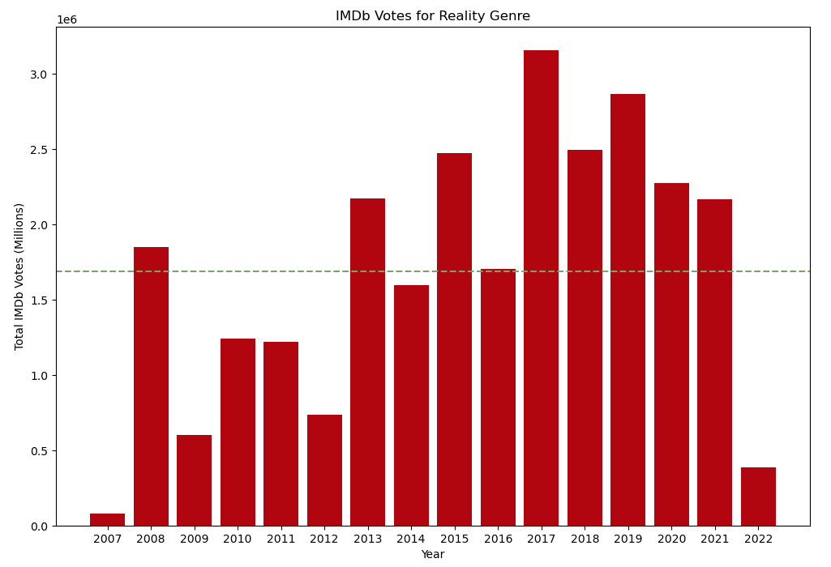
4
Did the pandemic change tastes in favour of reality TV?
Notes:
IMDb Votes for Reality Genre: The bar chart illustrates the total number of IMDb votes received by reality TV shows each year from 2007. There is a general upward trend in the number of votes, with some fluctuations, implying increasing viewer engagement over time with reality TV shows.

Slide 22
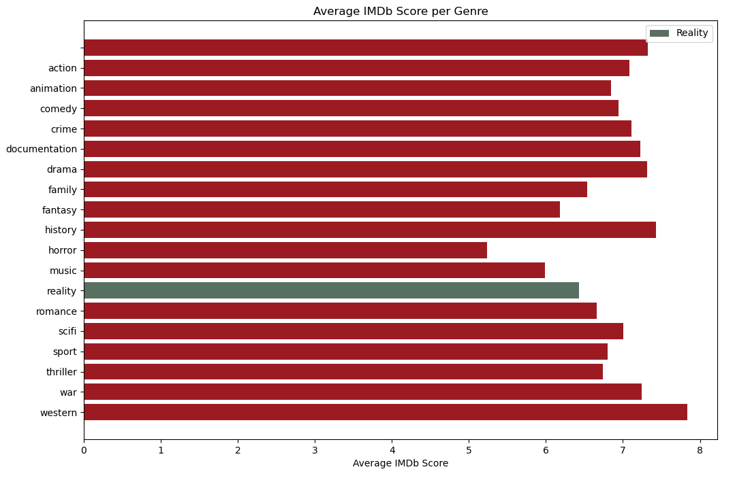
4
Did the pandemic change tastes in favour of reality TV?
Notes:
Average IMDb Score per Genre: This horizontal bar chart ranks genres by their average IMDb score, with reality TV highlighted in a different color. The chart indicates that reality TV has a lower average IMDb score compared to other genres, suggesting that while reality TV may be popular in terms of the number of shows produced and votes received, it may not be rated as highly in terms of quality or viewer satisfaction.
Overall Summary:
Sci-fi and action genres appear to engage viewers the most, leading to higher average IMDb votes.
There has been a significant rise in the production of reality TV shows, especially around 2021.
While the number of IMDb votes for reality shows has been increasing, indicating popularity, the average IMDb score for reality shows is lower compared to other genres.
The data suggests that while reality TV shows may be widely watched and voted on, they tend to have lower ratings, which may reflect critical reception or viewer satisfaction.

Slide 23


